Slide 1
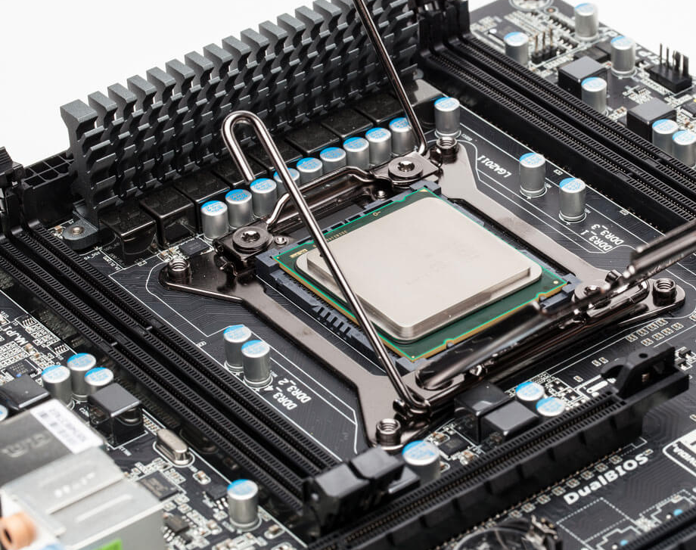
Process Management
Chapter Two
Notes:
NOTE: Want a different image on this slide? Select the picture and delete it. Now click the Pictures icon in the placeholder to insert your own image.

Slide 2
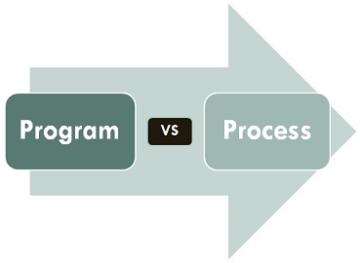
PROCESS
A process is an instance of a program running in a computer.
It is close in meaning to task, a term used in some OS.
A program by itself is not a process; a program is a passive entity, such as a file containing a list of instructions stored on disks. (often called an executable file)
A program becomes a process when an executable file is loaded into memory and executed.

Slide 3

Program is an executable file containing the set of instructions written to perform a specific job on our computer.
A program is piece of code which may be a single line or millions of lines.
Program are not stored on the primary memory on our computer. They are stored on a disk or secondary memory of our computer

Slide 4
Multiprogramming
Multiprogramming is also the ability of an operating system to execute more than one program on a single processor machine.
More than one task/program/job/process can reside into the main memory at one point of time.

Slide 5
Advantage
High CPU utilization.
The system looks fast as all the tasks runs in parallel.

Slide 6
Disadvantage
CPU scheduling is required.
To accommodate several jobs in memory, memory management is essential.

Slide 7
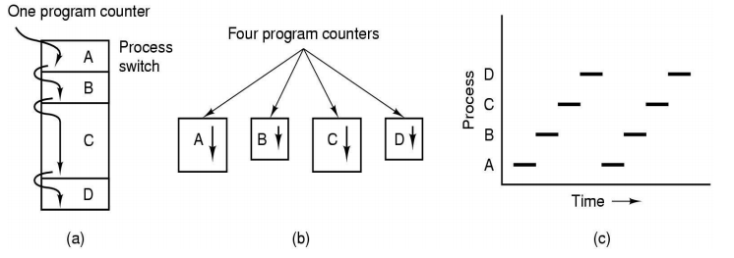
Process Model
In this model, all the runnable software in the computer, sometimes including operating system, is organized into number of sequential processes.
Multiprogramming model
Conceptual model
Only one program at a time

Slide 8
When a program is loaded into the memory and it becomes a process, it can be divided into four sections ─
stack
Heap
Text
data

Slide 9
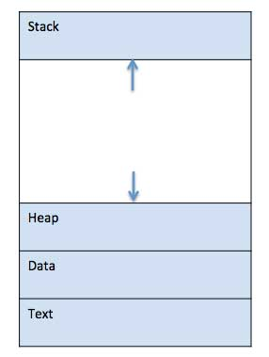

Slide 10
Stack
The process Stack contains the temporary data such as method/function parameters, return address and local variables.
Heap
This is dynamically allocated memory to a process during its run time.

Slide 11
Text
This includes the current activity represented by the value of Program Counter and the contents of the processor's registers.
Data
This section contains the global and static variables.

Slide 12
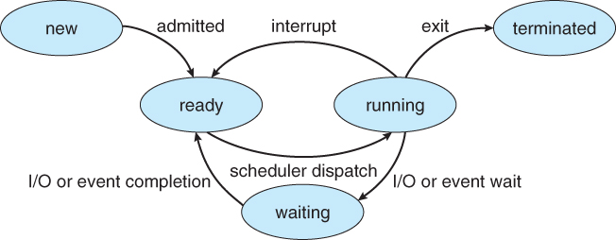
STATES OF PROCESS

Slide 13
START
In this step, the process is about to be created but not yet created, it is the program which is present in secondary memory that will be picked up by OS to create the process.

Slide 14
READY
The process is waiting to be assigned to a processor.
Ready processes are waiting to have the processor allocated to them by the operating system so that they can run.
Process may come into this state after Start state or while running it by but interrupted by the scheduler to assign CPU to some other process.

Slide 15
RUNNING
Once the process has been assigned to a processor by the OS scheduler, the process state is set to running and the processor executes its instructions

Slide 16
WAITING
Whenever the process requests access to I/O or needs input from the user or needs access to a critical region(the lock for which is already acquired) it enters the blocked or wait state.
The process continues to wait in the main memory and does not require CPU. Once the I/O operation is completed the process goes to the ready state.

Slide 17
TERMINATED
Once the process finishes its execution, or it is terminated by the operating system, it is moved to the terminated state where it waits to be removed from main memory.

Slide 18
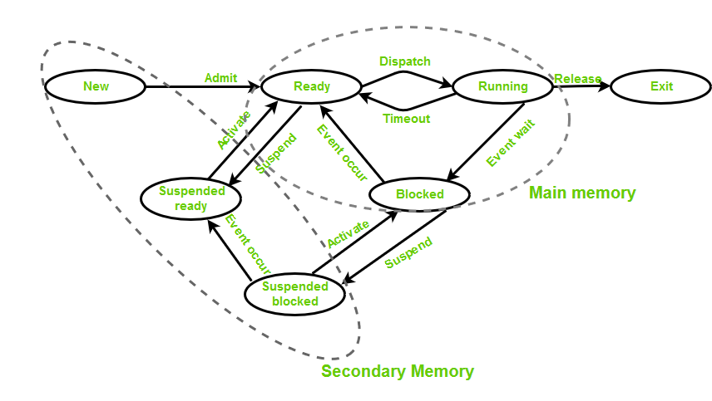

Slide 19
PROCESS CONTROL BLOCK

Slide 20
PROCESS CONTROL BLOCK
process control block (PCB) is used to track the process’s execution status.
A process control block (PCB) contains information about the process, i.e. registers, quantum, priority, etc.

Slide 21
FUNCTIONS
Naming the process
State of the process
Resources allocated to the process
Memory allocated to the process
Scheduling information
Input / output devices associated with process

Slide 22
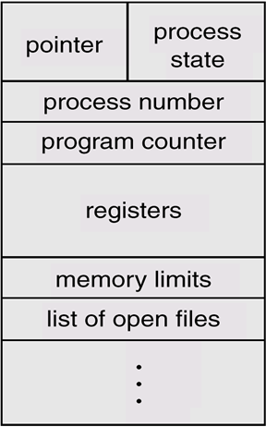

Slide 23
Process Control Block
Pointer
It is a stack pointer which is required to be saved when the process is switched from one state to another to retain the current position of the process.
Process state
It stores the respective state of the process.
Process number
Every process is assigned with a unique id known as process ID or PID which stores the process identifier.

Slide 24
Program counter
It stores the counter which contains the address of the next instruction that is to be executed for the process.
Register
These are the CPU registers which includes: accumulator, base, registers and general purpose registers.
Memory limits
This field contains the information about memory management system used by operating system. This may include the page tables, segment tables etc.
Open files list
This information includes the list of files opened for a process.

Slide 25





THREADS

Slide 26
WHAT IS THREAD?
A thread is the smallest unit of processing that can be performed in an OS.
A thread is also called a lightweight process. Threads provide a way to improve application performance through quasi parallel.
A thread exists within a process - that is, a single process may contain multiple threads.
Each thread belongs to exactly one process and no thread can exist outside a process.
It shares with other threads belonging to the same process its code section, data section, and other operating system resources, such as open files and signals.

Slide 27
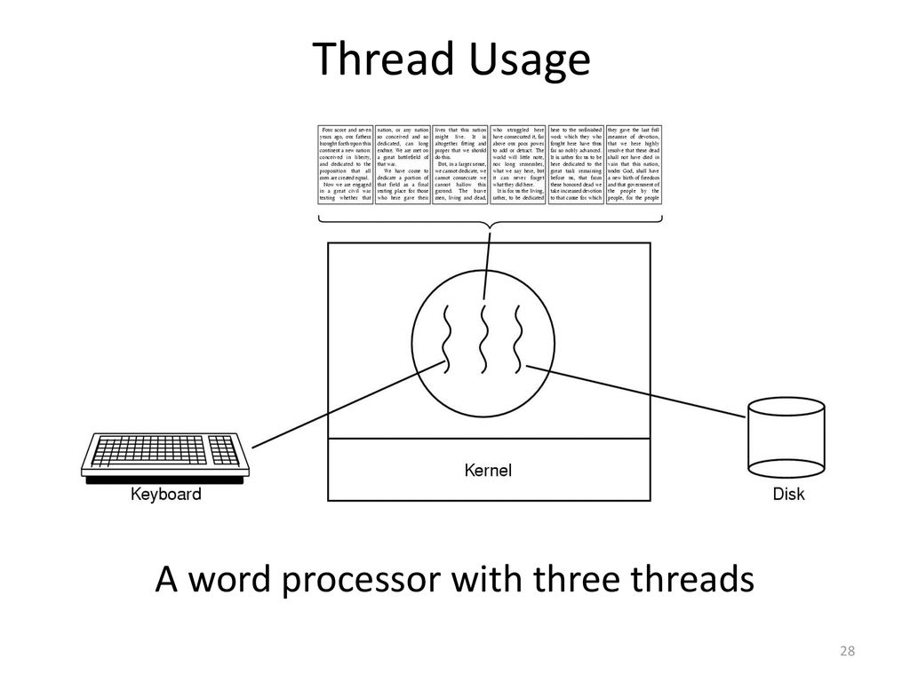

Slide 28
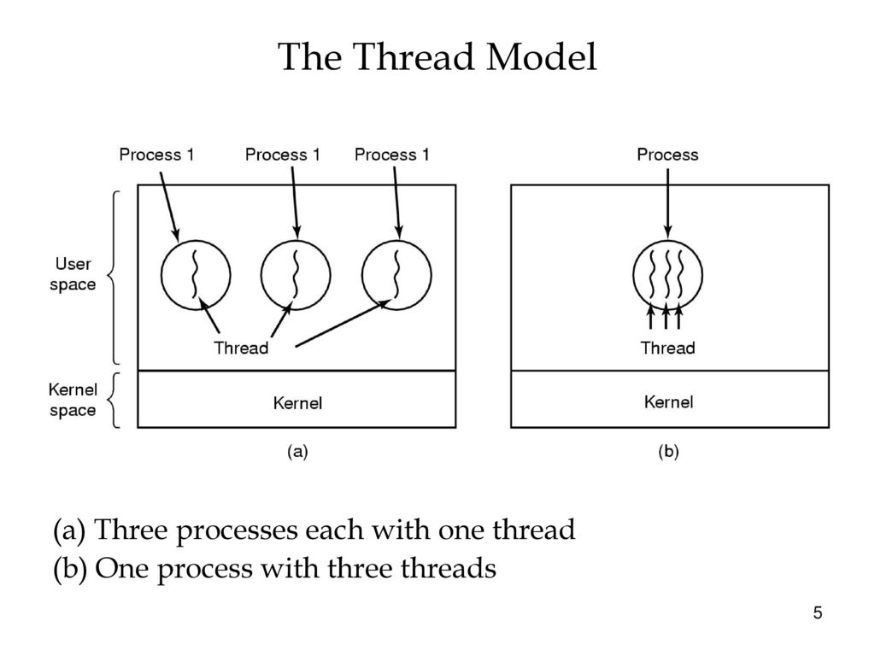

Slide 29
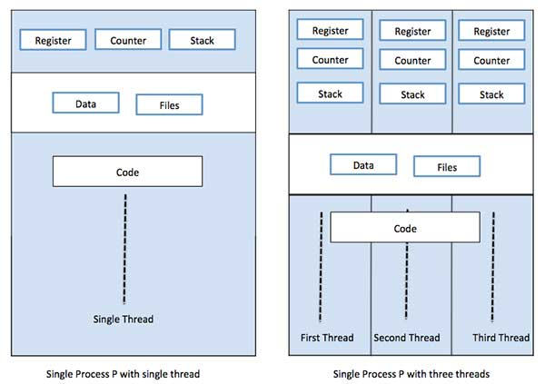
SINGLE THREAD AND MULTIPLE THREAD

Slide 30
PROCESS VS THREAD
Threads within the same process run in a shared memory space, while processes run in separate memory spaces.
Threads are not independent of one another like processes are NOT.
threads share with other threads their code section, data section, and OS resources (like open files and signals). But, like process, a thread has its own program counter (PC), register set, and stack space.

Slide 31
PROCESS VS THREAD
All threads of a program are logically contained within a process.
A process is heavy weighted, but a thread is light weighted.
A program is an isolated execution unit whereas thread is not isolated and shares memory.
A thread cannot have an individual existence; it is attached to a process. On the other hand, a process can exist individually.
At the time of expiration of a thread, its associated stack could be recovered as every thread has its own stack.

Slide 32
THREAD COTROL BLOCK
Very similar to Process Control Blocks (PCBs) which represents processes, Thread Control Blocks (TCBs) represents threads generated in the system. It contains information about the threads, such as its ID and states.

Slide 33
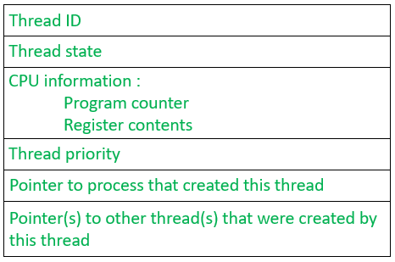

Slide 34
Thread ID: It is a unique identifier assigned by the Operating System to the thread when it is being created.
Thread states: These are the states of the thread which changes as the thread progresses through the system
CPU information: It includes everything that the OS needs to know about, such as how far the thread has progressed and what data is being used.

Slide 35
Thread Priority: It indicates the weight (or priority) of the thread over other threads which helps the thread scheduler to determine which thread should be selected next from the READY queue.
A pointer which points to the process which triggered the creation of this thread.

Slide 36
Two main ways to implement a threads package
User space thread
Kernel space thread

Slide 37
Types of Thread
User Space Threads
User managed threads.
Kernel Space Threads
Operating System managed threads acting on kernel, an operating system core.

Slide 38
User Space Threads
User level thread implement in user level libraries, so thread switching does not need to call operating system and to cause interrupt to the kernel.
The kernel knows nothing about user level threads and manages them as if they were single-threaded process.

Slide 39
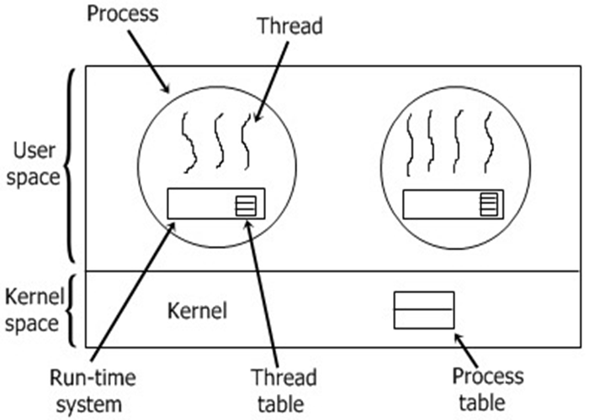

Slide 40
Advantages of ULT
User level threads does not require modification to operating system and are managed by user library.
User level threads are fast and efficient.
Context switching is fast.

Slide 41
Disadvantages of ULT
There is a lack of coordination between threads and operating system kernel.
ULT require non-blocking system call (i.e. Multithreaded kernel)

Slide 42
Kernel Level Threads (KLT)
In this method, the kernel knows about and manages the threads. No runtime system is needed in this case. Operating system kernel provides system call to create and manage threads.

Slide 43
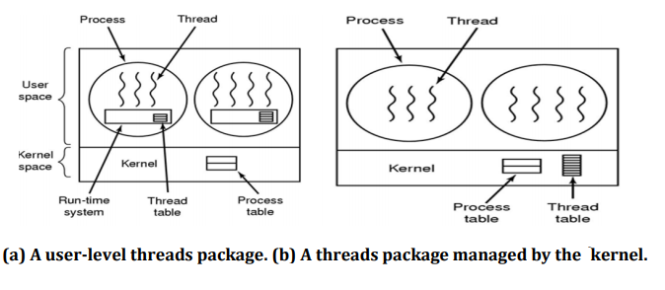

Slide 44
Advantages of KLT
Kernel can simultaneously schedule multiple threads from the same process.
If one thread in a process is blocked the kernel can schedule another thread of the same process.
Kernel routines themselves can multithreaded.

Slide 45
Disadvantages of KLT
Kernel thread are generally slower to create and manage than the user threads.
Kernel requires Thread Control Block (TCB) for each thread in the pool, hence complexity increases.

Slide 46
Operation on process

Slide 47
OPERATION ON PROCESS
Process Creation
Process Preemption
Process Blocking
Process Termination

Slide 48
Process Creation
Process creation means the construction of a new process for the execution. This might be performed by system, user or old process itself.
There are several events that leads to the process creation.
When we start the computer, system creates several background processes.
A user may request to create a new process.
A process can create a new process itself while executing.
Batch system takes initiation of a batch job.

Slide 49
Process Preemption
When a timeout occurs that means the process hadn’t been terminated in the allotted time interval and next process is ready to execute, then the operating system preempts the process. This operation is only valid where CPU scheduling supports preemption.

Slide 50
Process Blocking
When a process invokes an input-output system call that blocks the process and operating system put in block mode.

Slide 51
Process Termination
Process termination is the activity of ending the process.
Process completes its execution fully and it indicates to the OS that it has finished.
Operating system itself terminates the process due to service errors.
There may be problem in hardware that terminates the process.
One process can be terminated by another process.

Slide 52
INTER PROCESS COMMUNICATION
Inter-process communication (IPC) refers specifically to the mechanisms an operating system provides to allow the processes to manage shared data.
Issues for inter-process communication
Output of one process must be passed to the second process.
Two or more process get in each other's way.
Concerns proper sequencing when dependencies are present

Slide 53
Processes executing concurrently in the operating system may be either independent process or co-operating process.
Independent process:
A process is independent if it can't affect or be affected by another process.
Co-operating Process:
A process is co-operating if it can affect other or be affected by the other process.
Any process that shares data with other process is called cooperating process.

Slide 54
There are several reasons for providing an environment that allow process cooperation:
Information sharing
Computation speedup
Modularity
Convenience

Slide 55
Information sharing
Sharing of information between multiple processes can be accomplished using cooperating processes. This may include access to the same files. A mechanism is required so that the processes can access the files in parallel to each other.

Slide 56
Computation speedup
Subtasks of a single task can be performed parallelly using cooperating processes. This increases the computation speedup as the task can be executed faster. However, this is only possible if the system has multiple processing elements.

Slide 57
Modularity
Modularity involves dividing complicated tasks into smaller subtasks. These subtasks can complete by different cooperating processes. This leads to faster and more efficient completion of the required tasks.

Slide 58
Convenience
There are many tasks that a user needs to do such as compiling, printing, editing etc. It is convenient if these tasks can be managed by cooperating processes.

Slide 59
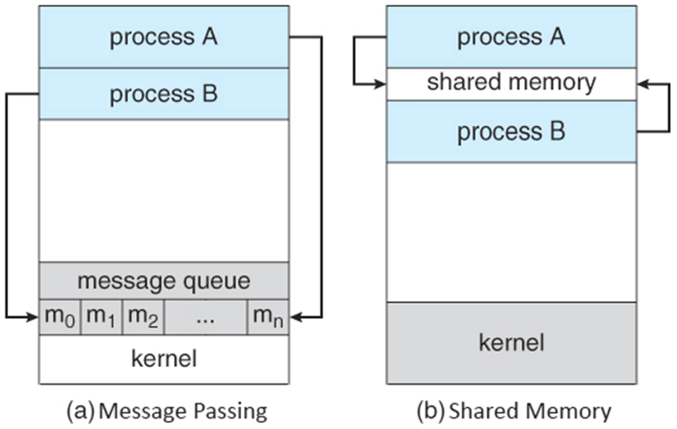
Methods of Cooperation

Slide 60
Shared Memory
Requires communicating processes to establish a region of shared memory,
A shared-memory region resides in the address space of the process creating the shared-memory segment.
Other process that wish to communicate using shared-memory segment must attach it to their address apace.

Slide 61
Message-Passing
Communication takes place by means of messages exchanged between the co-operating process
Message passing is useful for exchanging the smaller amount of data.
Easier to implement than shared memory.
Slower than that of Shared memory as message passing system are typically implemented using system call Which requires more time-consuming task of Kernel intervention.

Slide 62
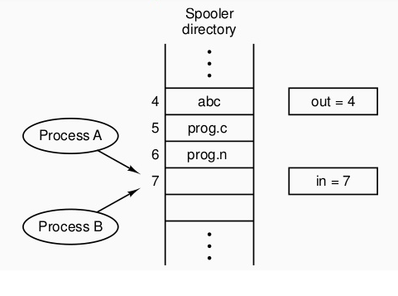
RACE CONDITION
A race condition occurs when two or more process can access shared data and they try to change it at the same time.

Slide 63
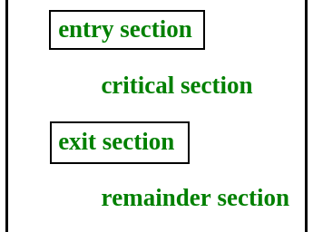
CRITICAL SECTION
When more than one processes access a same code segment that segment is known as critical section.
Contains shared variables or resources which are needed to be synchronized to maintain consistency of data variable.

Slide 64
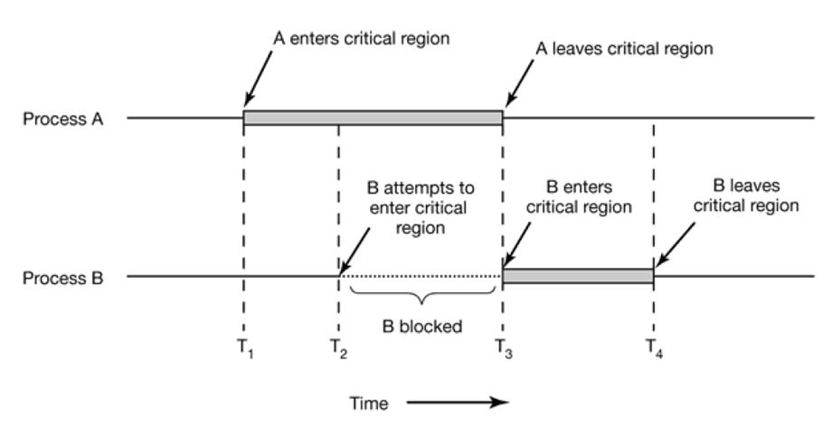

Slide 65
Implementation mutual exclusion

Slide 66
Critical Regions and solution
Solution to Critical section problem:
No two processes simultaneously in critical region
No assumptions made about speeds or numbers of CPUs
No process running outside its critical region may block another process
No process must wait forever to enter its critical region

Slide 68
Busy waiting
Continuously testing a variable until some value appears is called busy waiting.
If the entry is allowed, it execute else it sits in tight loop and waits.

Slide 69
Managing Race Condition
Mutual Exclusion with busy waiting
Disabling Interrupts
Lock Variable
Strict Alternation
Peterson’s Solution
Mutual Exclusion without Busy Waiting
Sleep and wakeup
Semaphore
Message Passing
Monitor

Slide 70
Disabling Interrupts
On a single processor system, the simplest solution is to have each process disable all interrupts just after entering its critical region and re-enable them just before leaving it.
With interrupts disabled, no clock interrupts can occur. The CPU is only switched from process to process as a result of clock or other interrupts, after all, and with interrupts turned off the CPU will not be switched to another process.
But, disabling interrupts, is a major undertaking. At best, the computer will not be able to service interrupts for, maybe, a long time (who knows what a process is doing in its critical section?). At worst, the process may never enable interrupts, thus (effectively) crashing the computer.

Slide 71
Lock Variable
Consider having a single, shared (Lock variable), initially 0. When a process wants to enter its critical region, it first tests the lock. If the lock is 0, the process wants to enter its critical region, it first test the lock.

Slide 72
Strict Alternation
Turn=0
(a)
while (1)
{
W hile(turn != 0) /* loop* /;
critical_region();
turn = 1;
noncritical_region();
}

Slide 73
(b)
{ while (1)
while(turn != 1) /* loop* /;
critical_region();
turn = 0;
noncritical_region(); }

Slide 74
Solution to Critical section problem:
No two processes simultaneously in critical region
No assumptions made about speeds or numbers of CPUs
No process running outside its critical region may block another process
No process must wait forever to enter its critical region

Slide 75
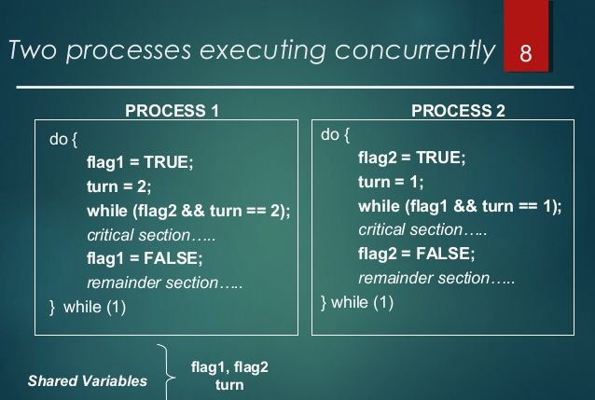
Peterson's Solution

Slide 76
TSL(Test and Set Lock)
Takes some help of Hardware.
Many multiprocessor system have an instruction

Slide 77
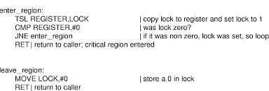

Slide 78
SLEEP AND WAKE
Both Peterson and TSL solution have defect of requiring Busy waiting which lead to
CPU time wasted
Priority Inversion Problem
These problem can be solved by using Sleep and Wakeup primitives (System Calls).
SLEEP
WAKEUP

Slide 79
SLEEP
Sleep is a system call that causes the caller to block, that is, be suspended until another process wakes it up.
Wakeup
Wakeup system call awakens the process. It has one parameter which is process itself.

Slide 80
Producer-Consumer Problem (Bounded Buffer Problem)
Consist of two process, Producer and Consumer
They share a common fixed size Buffer
Producer puts information into Buffer
Consumer takes information out of Buffer

Slide 81
When the producer wants to put information, but the buffer isn't empty.
Producer go to sleep
To be awakened when consumer removes a item from buffer.
When the consumer wants to take information from the buffer , but the buffer is empty.
Consumer go to sleep
To be awakened when producer put information in the buffer

Slide 82
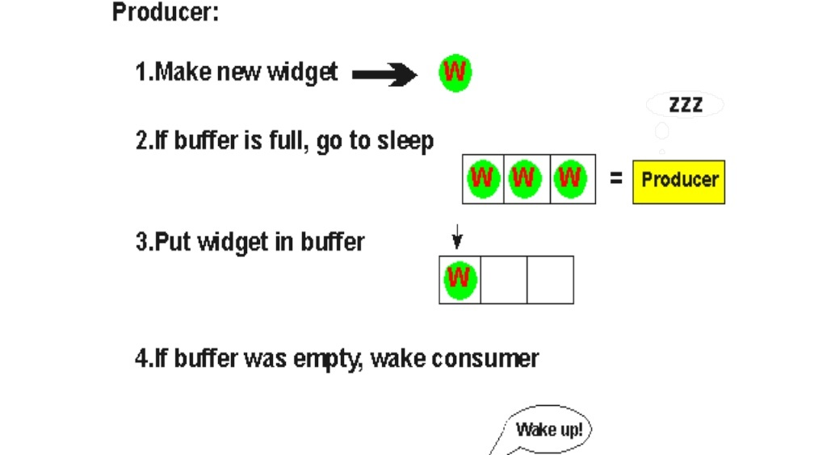

Slide 83
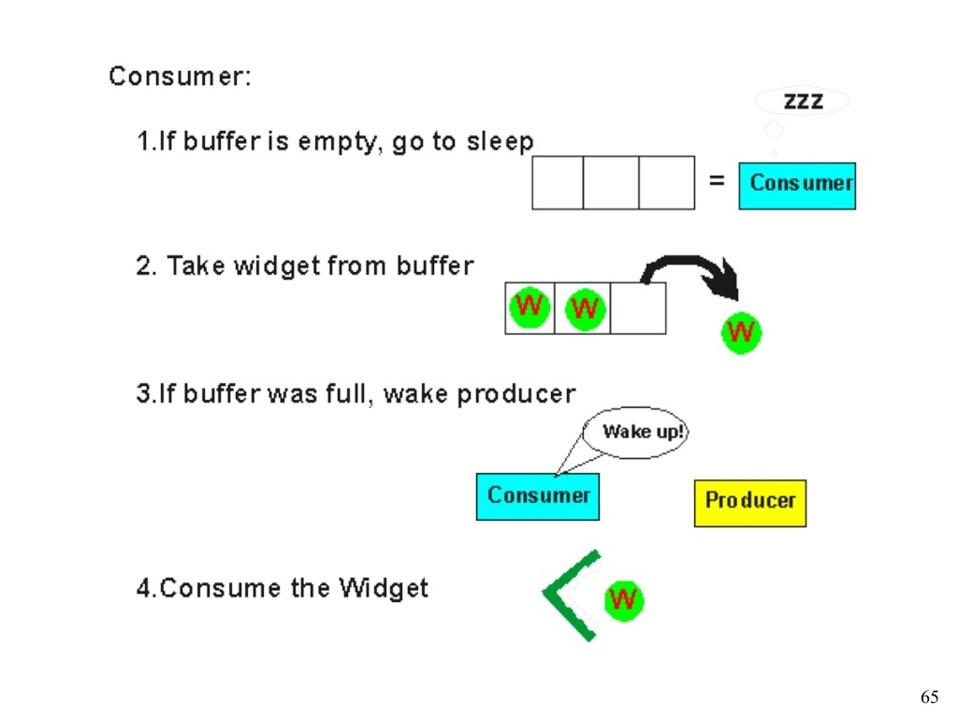

Slide 84
#define N 100 /* number of slots in the buffer */
int count = 0; /* number of items in the buffer */
void producer(void)
{
int item;
while (TRUE)
{ /* repeat forever */
item = produce_item(); /* generate next item */
if (count == N) sleep(); /* if buffer is full, go to sleep */
insert_item(item); /* put item in buffer */
count = count + 1; /* increment count of items in buffer */
If (count == 1) wakeup(consumer); /* was buffer empty? ie. initially */ } }

Slide 85
void consumer(void)
{
int item; while (TRUE)
{ /* repeat forever */
if (count == 0) sleep(); /* if buffer is empty, got to sleep */
item = remove_item(); /* take item out of buffer */
count = count - 1; /* decrement count of items in buffer */
if (count ==N - 1) wakeup(producer); /* was buffer full? */
consume_item(item); /*consume item */
}
}

Slide 86
Semaphores
Semaphore is an integer variable to count the number of wakeup processes saved for future use.
A semaphore could have the value 0, indicating that no wakeup processes were saved, or some positive value if one or more wakeups were pending.
There are two operations, down (wait) and up(signal) (generalizations of sleep and wakeup, respectively).

Slide 87
Semaphore S; // initialized to 1
Do{
wait (S);
Critical Section
signal (S);
} while(T)

Slide 88
Implementation of wait:
wait(s)
{
while(s<=0); // do nothing
s=s-1;
}
Implementation of signal:
signal(s)
{
s=s+1;
}

Slide 89
#define N 100 /* number of slots in the buffer */
typedef int semaphore; /* semaphores are a special kind of int */
semaphore mutex = 1; /* controls access to critical region */
semaphore empty = N; /* counts empty buffer slots */
semaphore full = 0; /* counts full buffer slots */

Slide 90
Producer-consumer problem using semaphores
void producer(void)
{
int item;
while (TRUE){ /* TRUE is the constant 1 */
item = produce_item(); /* generate something to put in buffer */
down(&empty); /* decrement empty count */
down(&mutex); /* enter critical region */
insert_item(item); /* put new item in buffer */
up(&mutex); /* leave critical region */
up(&full); /* increment count of full slots */
}
}

Slide 91
void consumer(void)
{
int item;
while (TRUE){ /* infinite loop */
down(&full); /* decrement full count */
down(&mutex); /* enter critical region */
item = remove_item(); /* take item from buffer */
up(&mutex); /* leave critical region */
up(&empty); /* increment count of empty slots */
consume_item(item); /* do something with the item */
}
}

Slide 92
This solution uses three semaphore.
1. Full:
For counting the number of slots that are full, initially 0
2. Empty:
For counting the number of slots that are empty, initially equal to the no. of slots in the buffer
3. Mutex:
To make sure that the producer and consumer do not access the buffer at the same time, initially 1.

Slide 93
Moniters
In concurrent programming, a monitor is an object or module intended to be used safely by more than one thread.
The defining characteristic of a monitor is that its methods are executed with mutual exclusion.
That is, at each point in time, at most one thread may be executing any of its methods.
Monitors also provide a mechanism for threads to temporarily give up exclusive access, it has to wait for some condition to be met, before regaining exclusive access and resuming their task.
Monitors also have a mechanism for signaling other threads that such conditions have been met.

